Slide 1
Microservices and Web Application Architecture
Web Development Day 2
1

Slide 2
Class Objectives
By the end of today’s class, we’ll be able to:
Understand how microservices and architecture work to deliver more robust, reliable, and repeatable infrastructure as code.
Define the different services within a LEMP stack.
Deploy a Docker Compose container set and test the deployment functionality.
Describe how relational databases store and retrieve data.
Create SQL queries to view, enter, and delete data.

Slide 3
Application Structure
3

Slide 4

Introduction to Microservices
Today, we’ll set up and secure microservices.
First, we need to understand the following:
How an application and its components are organized.
How information flows between components of an application.
How application architecture has changed from monoliths to microservices.
How to deconstruct a monolith into microservices.
4
Notes:
Image source: shutterstock_763372021

Slide 5
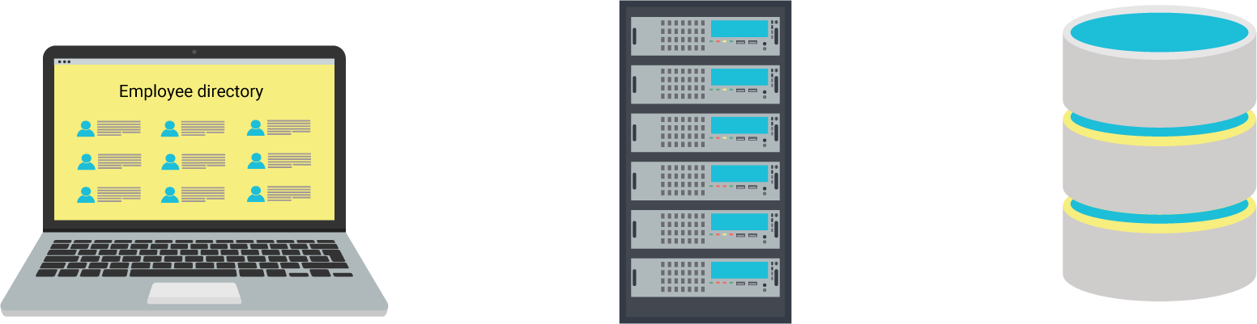

Components of a Typical Web App
Front-end server
To display webpages and style them in readable formats. Also responsible for receiving and responding to HTTP requests.
A developer, Andrew, often uses a browser to manage a public-facing employee directory application to retrieve and update different employee lists from his company.
The employee directory application is set up so that Andrew can add, remove, and display employees.
The employee directory application needs to access the following components:
Back-end server
Executes business logic and writes or reads corresponding data to and from a database.
Database
Stores information about employees, such as their employee IDs and names. Info can be critical and sensitive.
5
Notes:
Image source: shutterstock_704749705

Slide 6

Information Flows Between Application Components
Andrew loads the application in his browser and clicks a button to display all HR employees.
Browser displays new page with a formatted list of HR employees.
Now that we know the main components of a web application, we want to know what happens behind the scenes when a user interacts with a web application, or more specifically, makes an HTTP request to the server.
Employee Directory Application
Front end prepares a new webpage with a list of all HR employees.
Front end forwards request to back end.
Front-end server
A back-end script queries the database for HR employees.
Back-end script forwards list of HR employees to front end.
Back-end server
Database searches for all IDs with “HR.”
Database sends IDs with “HR” to back end.
Database
6
Notes:
Image source: shutterstock_704749705

Slide 7
Monolith to Microservices
7

Slide 8

Understanding application components is key to understanding the modern architectural paradigm of microservices.
Let’s first explore the original architecture type, the monolith, and the issues that led to the adoption of microservices.
Notes:
Image source: shutterstock_1083618569

Slide 9
Monolith
A monolith is a single machine that hosts all the components required to serve a website or application.
In other words, a monolith is a machine that has a front-end server, back-end server, and a database.
9
Notes:
Image sources: shutterstock_329468402, shutterstock_417078436, shutterstock_704749705

Slide 10
Monolith
1
Suppose Amazon is using a monolithic server. It would contain:
Front-end HTML server: GUI for customers to look at while shopping.
Back-end application server: Back-end server showing the inventory and stock. Interacts directly with the database.
MySQL database: Database of customers, and their information and purchases.
1
2
2
3
3
10
Notes:
Image source: shutterstock_704749705

Slide 11
Monolith
1
The components of a single machine are highly dependent on each other. If any component malfunctions, the entire application will malfunction.
Hackers, environmental issues, and human errors can threaten the entire machine.
Updating a single component means taking down all components, resulting in downtime and lack of availability.
2
3
11
Notes:
Image source: shutterstock_704749705

Slide 12
Problems with Monoliths
It’s now expected that companies will ensure availability by maintaining almost 100% uptime. The risk associated with a interdependent monolithic system presented problems.
Separating an application's components into their own machines (microservices) means the sysadmin can update the front end, reboot it, and only have to verify the front-end components—not the back-end components and database.
If a component is compromised by a hacker, the potential damage is restricted to only that component.
12
Notes:
Image sources: shutterstock_329468402, shutterstock_417078436, shutterstock_704749705

Slide 13
Microservices
Each independent machine is a component that executes one primary function or service.
We already implemented microservices when we covered cloud security:
A jump box to connect to a private Ansible server.
An Ansible server to configure DVWA servers.
DVWA servers to provide the DVWA service.
A Docker image to provide WordPress.
13
Notes:
Image sources: shutterstock_329468402, shutterstock_417078436, shutterstock_704749705

Slide 14
Benefits of Microservices
Scalability and resilience
Rapid response
Isolated improvement
Isolated security
Replication of components lets you serve more clients and provides identical backup components if one fails.
Microservice components are smaller, so they can be replaced and updated quickly.
Microservices serve one primary function, so they can be developed with the goal of optimizing their functionality.
One compromised component does not equal a compromised application.
14

Slide 15
APIs
15

Slide 16

APIs
When Amazon customers want to retrieve a list of all the newest and most popular books, they do not go to the back-end MySQL server to check the inventory.
They go to the front-end microservice.
Then, the microservice communicates with the back-end server, and brings up the relevant data.
Customers do not have access to the back-end server. The back end does not accept HTTP requests, meaning users can't
communicate with it.
16
Notes:
Image source: shutterstock_1049725370

Slide 17
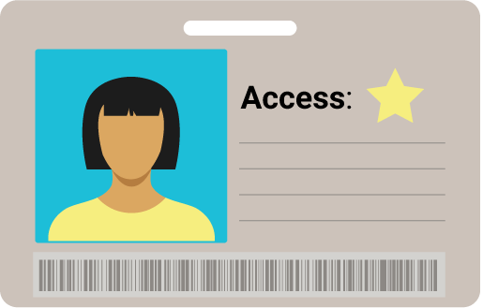
APIs
Product directory app
Systems administrators need to access and query the back end to update product information.
Since they need to directly communicate with the back end, they must modify it to accept requests.
Software developers will program the back end to receive, from sources other than the front-end, HTTP requests to add, remove, and display product information.
Requests and responses for product info
Requests and responses for
product info
Product API
System Administrator
Database queries to interact with product info
The back-end server is an application programming interface (API): the implementation of new protocols or features onto an existing application to alter the way it is used or accessed.
Inventory database
17
Notes:
Image sources: shutterstock_329468402, shutterstock_417078436, shutterstock_704749705

Slide 18

Challenges of Microservices
A product directory app is down? Rerouting users to the other two!
User requests
Terminated connection
Load balancer
Microservice complexity and interconnectivity also come with unique security issues.
Microservices have increased complexity and require more maintenance as the application and number of components grows.
Product
directory
apps
Requests and responses for product info
Product API
Database queries to interact with product info
Inventory database
18
Notes:
Image sources: shutterstock_329468402, shutterstock_417078436, shutterstock_704749705

Slide 19
Monolith to Microservice
In the next activity, you will diagram microservices.
01
Separate each component of the monolith by its function and move it to its own machine.
02
Add communication between each part of the microservice.
03
Turn the back-end server into an API to interact with more than just the front end.
04
Rename the rest of the component services to match the main function they provide.
19

Slide 20
Activity: Monolith to Microservice
In this activity, you will diagram a microservice version of a monolith web store application.
15 Minutes
20

Slide 21
21

Slide 22
Web Application Architecture
22

Slide 23
Web Application Architecture
One of the first steps to creating microservices is separating the components into their own individual machines so that each one can run a “service.”
A service, such as the front-end server from our earlier examples, is really just an operating system, running the minimum software that was configured to serve one main purpose, such as handle HTTP requests and responses.
Front-end HTML server
Back-end application server
MySQL database
23
Notes:
Image sources: shutterstock_329468402, shutterstock_417078436, shutterstock_704749705

Slide 24
Web Application Architecture
Each individual machine requires:
An operating system to run on, in order to run the service's software and store its configurations.
The software that runs a specific set of instructions for that individual component of the web application.
For example: A database service may run Linux as its operating system, and then have a MySQL database installed on it.
24
Notes:
Image sources: shutterstock_329468402, shutterstock_417078436, shutterstock_704749705

Slide 25
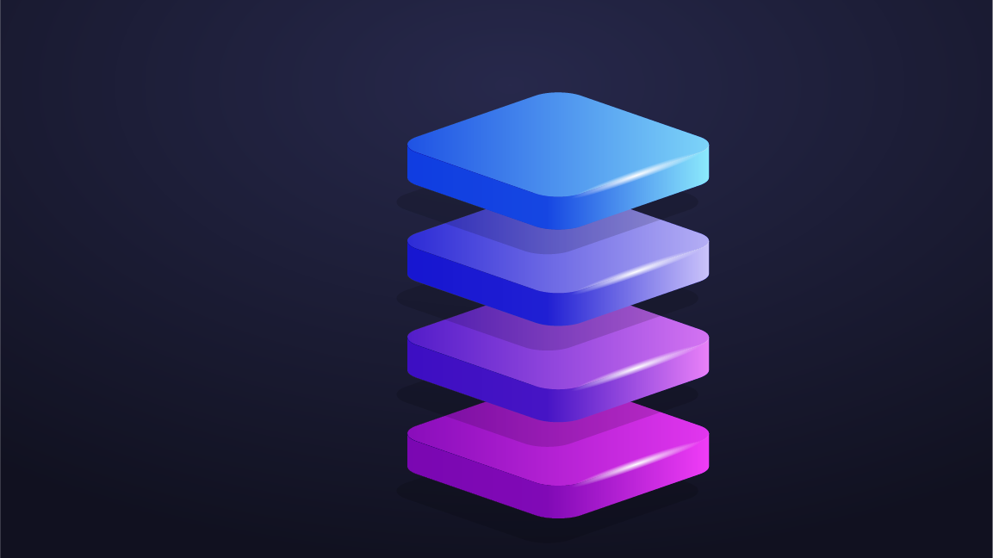
Introducing Stacks
What open-source and commercial software do we need to set up in order to create our web application components?
Base operating system
Front-end software
Any combination of a base operating system, front-end software, back-end software, and a database is called a web stack.
Back-end software
Database
25
Notes:
shutterstock_1284781774

Slide 26
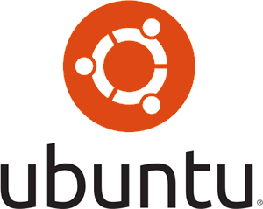




LAMP Stack
A popular example of a stack is the LAMP stack.
L
Linux, as the base operating system.
A
Apache, to handle the frontend HTTP requests/responses.
M
MySQL, for storing data.
P
PHP, for back-end transformation of front-end requests and responses to database queries.
26

Slide 27
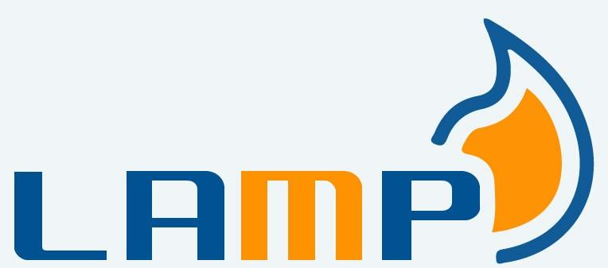


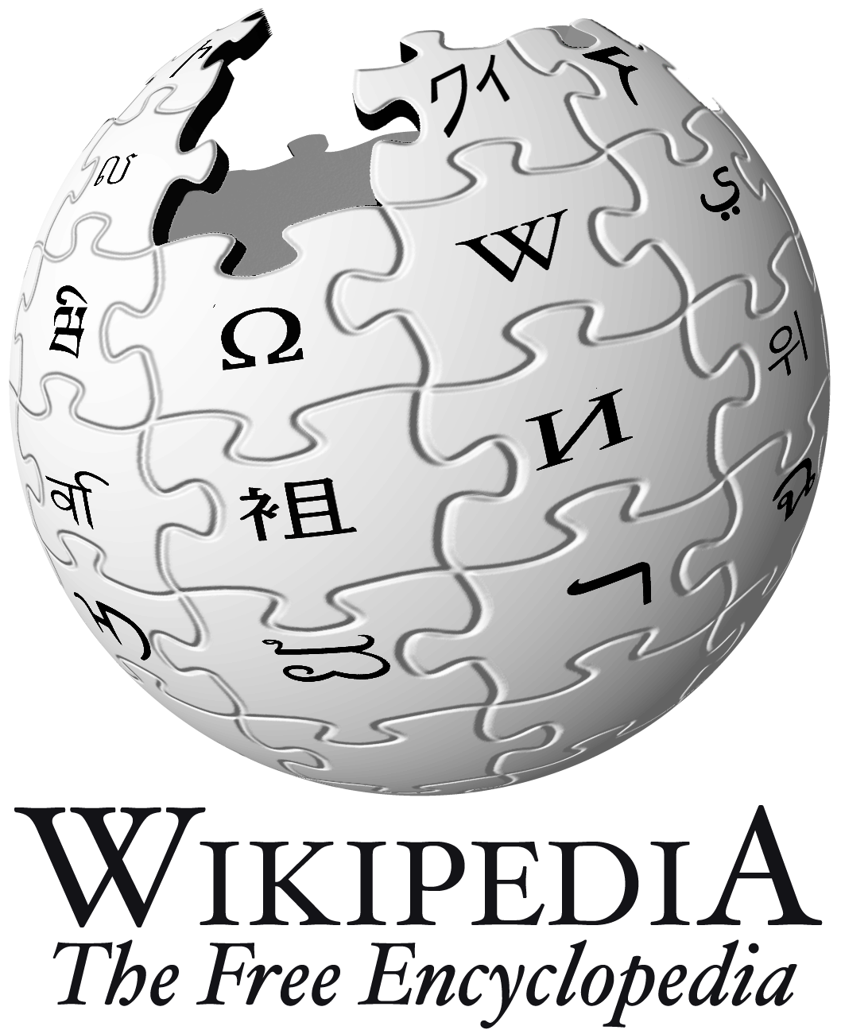


LAMP Stack
The LAMP stack is considered the tried and true web stack, with a long history of use in architecting web applications.
The following sites either still use or originally used the LAMP stack:
27

Slide 28
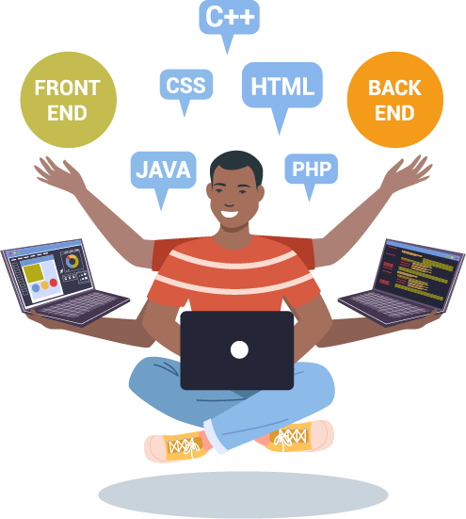
More Stacks
These days, there are many more web stacks, which use different variations of software.
But what stacks should we use. for our own web application?.
Let’s take a look at some options.
28
Notes:
Shutterstock_1647368755_multitask WITH character frrom CANVAS scripts incorporated for diversity. See Trilogy VSG https://drive.google.com/drive/u/0/search?q=Trilogy%20VSG

Slide 29






Common Web Architecture: Operating Systems
Let’s start by comparing the different operating systems available for our services.
The Alpine Linux is a super lightweight Linux distribution that has the minimum requirements to run containers.
Other container-friendly operating systems include most other Linux distributions, such as Ubuntu, and more recent versions of Windows Server.
The following is a list of base operating systems used for web applications:
Common Linux distros such as:
Windows Server 2016 and higher
29
Notes:
shutterstock_1035080362

Slide 30
Common Web Architecture: Front-end Server
Front-end server is the part of a web application that renders the visual components of a web application. HTML, CSS, and JavaScript are the primary front-end web design languages.
Our front-end server handles the HTTP requests and responses.
It is usually some form of HTTP server running on a lightweight containerized operating system.
Examples include:
Apache
nginx
IIS
30
Notes:
Image sources: shutterstock_329468402, shutterstock_417078436, shutterstock_704749705

Slide 31
Common Web Architecture: Database Server
The database server is the part of the web application that houses data for the application.
Examples include:
MySQL
MariaDB
PostgreSQL
Microsoft SQL Server
CouchDB
MongoDB
Remember that there can be multiple databases, some for storing sessions and cookies, some for storing business logic like a company's employee directory.
31
Notes:
Image source: shutterstock_704749705

Slide 32
Common Web Architecture: Back-end Server
These servers run fully-featured scripting and programming languages.
Lastly, we’ll usually need a back-end server that transmits data between the front-end and the database.
Examples of back-end servers and languages include:
PHP
Perl
Python
nodeJS
32
Notes:
Image sources: shutterstock_329468402, shutterstock_417078436, shutterstock_704749705

Slide 33
Honorable Mention: The WIMP Stack
There is also a Microsoft-based variation called the WIMP stack that uses the following:
W
Windows operating system
I
Microsoft’s IIS web server in place of Apache/nginx
Like the LAMP stack, we won't be using WIMP in class, but it is good to know that Microsoft-based web stacks are available.
M
A database, such as Microsoft SQL Server
P
Back-end language, such as PowerShell
33

Slide 34



Introducing the LEMP Stack
The web software stack that we’ll be using for today’s demos and activities consists of:
L
Linux
E
nginx (pronounced “engine-x”)
M
MariaDB, and
P
PHP
34

Slide 35
LEMP Stack
L
Linux The standard underlying operating system used for web applications. However, we will be using it with containers.
E
nginx We'll be using nginx for our frontend HTTP server, instead of Apache, mainly for its speed. While Apache is considered to have more features and is more compatible with back-end languages, such as Java, nginx is well-known for its performance.
M
MariaDB Unofficially the "other" MySQL, it is a standard relational database that will handle our data storage.
P
PHP Our pages will be generated with data pulled by PHP scripts. We will not need to manage or work with any PHP directly today, but know that it is acting as our back-end language.
35

Slide 36
Now that we figured out the software, we need to work out a hardware environment suitable for web application microservices that is both lightweight and easy to deploy.
Notes:
Image source: shutterstock_1083618569

Slide 37

Microservice Infrastructure
Microservices require lightweight environments to run because:
Live services need to be deployed quickly.
Multiple copies of a service can be replicated as needed to meet demand.
Developers and maintainers can deploy their own copies of these services locally for testing purposes.
Full-sized VMs for each service require more resources and are more expensive.
37

Slide 38

Each service needs its own lightweight virtual environment.
Can we think of any technologies that provide a lightweight, isolated environment?
38
Notes:
Image source: shutterstock_1139926778

Slide 39
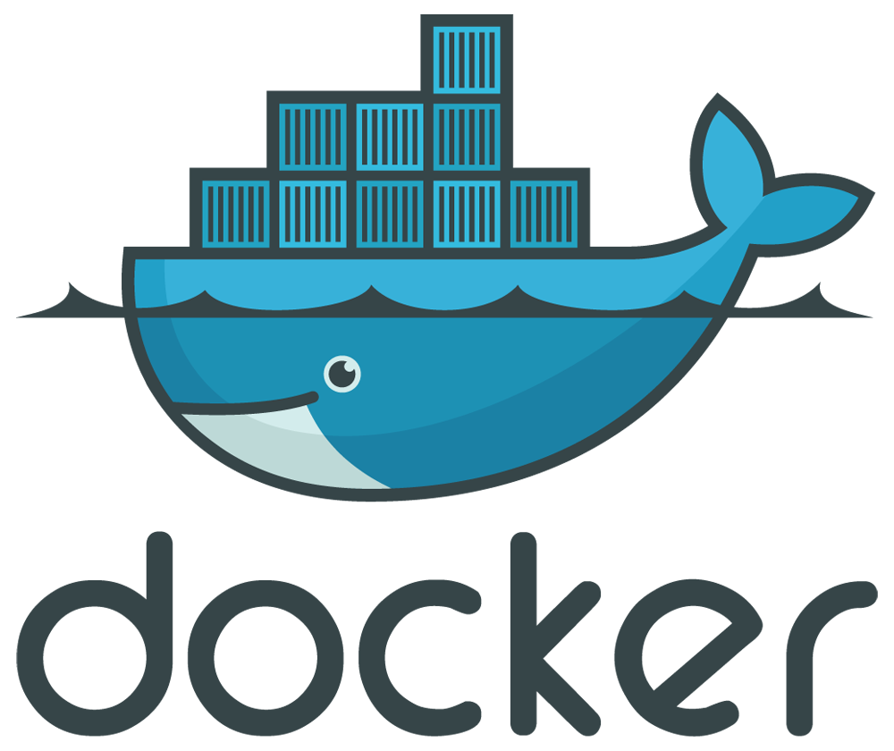
Microservice Infrastructure with Containers
In the cloud security unit, we covered containers and Docker extensively. We also used Ansible to set up lightweight containers in our activities.
Containers run as isolated, virtual operating systems that dynamically allocate resources depending on needs. This is unlike regular virtual machines, where all hardware is virtualized.
Docker is the most popular container platform. For the rest of this class, we will be referring to Docker’s implementations of containers.
39

Slide 40
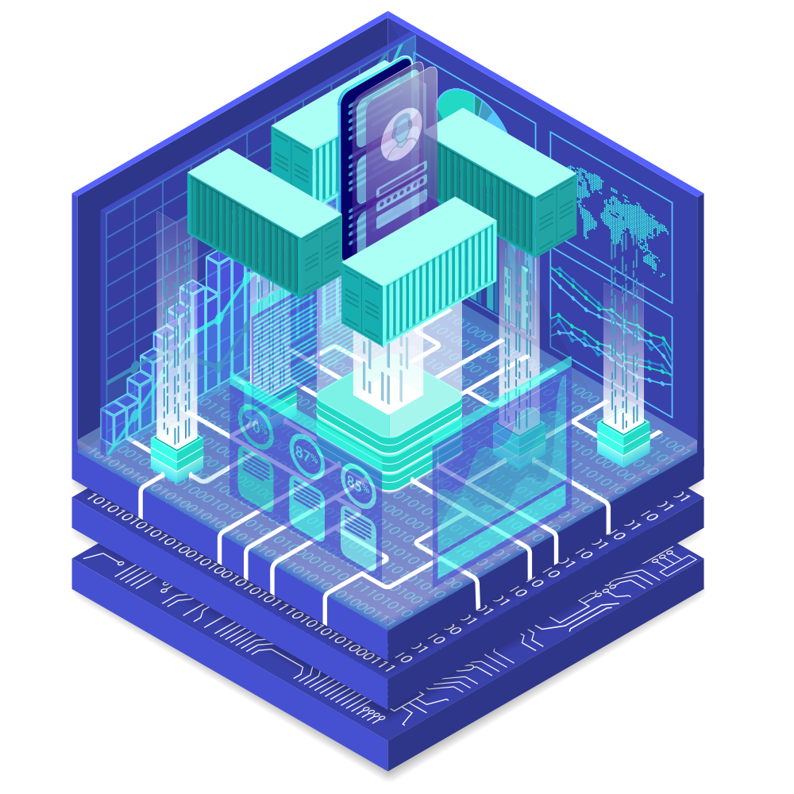
Containerization is the process of packaging all the requirements for a microservice into a container.
40
Notes:
Image source: shutterstock_1326085205

Slide 41
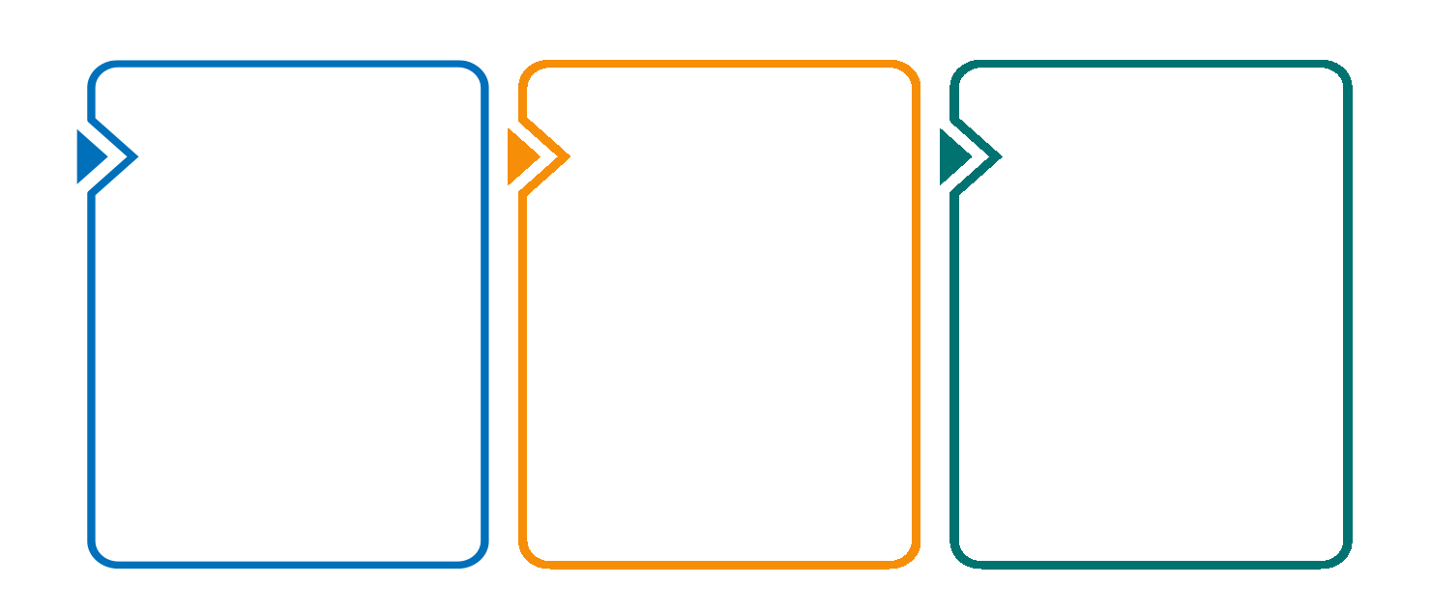
How a Container Becomes a Microservice
Containerizing a microservice requires the following steps:
Declare a base operating system for the microservice to run on.
Copy the microservice’s source code to the container.
Set a command that launches the microservice.
41
Notes:
Image source: shutterstock_1367319962

Slide 42
Dockerfile
Containerization can be declared in a text file called a Dockerfile.
###############################
# Employee Directory Application
###############################
# Required Base OS
FROM ubuntu:14.04
...[truncated]
Dockerfiles contain all the configuration needed for a container in one file.
This is similar to an Ansible configuration file, which contains everything needed to configure a host with the command ansible-playbook your-playbook.yml.
42

Slide 43
Dockerfile
A unique Dockerfile is created for each microservice.
#######################
# Product Directory Application
#######################
# Required Base OS
FROM ubuntu:14.04
Dockerfile
Product Directory app
Dockerfile
#######################
# PRODUCT API
#######################
# Required Base OS
FROM fedora:31
Product API
Dockerfile
#######################
# AMAZON Database
#######################
# Required Base OS
FROM centos:8
Amazon database
43
Notes:
Image sources: shutterstock_329468402, shutterstock_417078436, shutterstock_704749705

Slide 44
Deploying and Testing a Container Set
44

Slide 45
Deploying at Scale
Deploying containers can be tedious, especially if a business requires hundreds or thousands of microservices. Therefore we need to know how to deploy in large-scale environments. Specifically, how to:
Deploy copies of containers we want replicated.
Set up a network for our containers so they can communicate with each other.
Deploy multiple types of containers at the same time.
For example, front-end and database services.
45
Notes:
Image source: shutterstock_1367319962

Slide 46
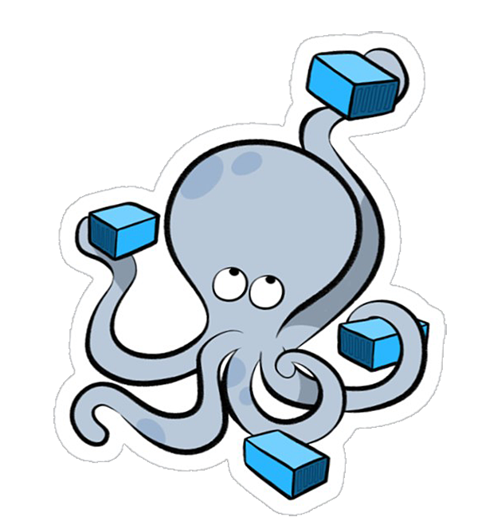
Deploying at Scale
We’ll use Docker Compose to enable these large-scale deployments.
Docker Compose allows us to create repeated, multi-container deployments.
compose
Remember: We used Docker Compose in the last class to set up our WordPress site.
46

Slide 47
Docker Compose YAML File
We also used YAML files to deploy Ansible playbooks during our cloud security unit.
version: "3.7"
services:
ui:
image: httpd:2.4
ports:
- 10000:8080
volumes:
- ./volume:/home
networks:
demo-net:
ipv4_address: 192.168.1.2
[truncated…]
Docker Compose uses YAML to define the containers, their networking configurations, and where you want to copy files from your host machine into your container.
47

Slide 48
Docker Compose Demo
For this web application deployment demo, we’ll complete the following steps:
01
Examine the YAML file for its current configurations.
02
Launch our services with sudo docker-compose up.
03
Use our browser to verify the our front-end user interface (ui) services are deployed properly.
04
Enter a MySQL session to confirm proper deployment of our database service.
48

Slide 49
Docker Compose
49

Slide 50
version: "3.3"
services:
ui:
image: httpd:2.4
ports:
- 10000:8080
volumes:
- ./volume:/home
networks:
demo-net:
ipv4_address: 192.168.1.2
db:
image: mariadb:10.5.1
restart: always
environment:
MYSQL_DATABASE: demodb
MYSQL_USER: demouser
MYSQL_PASSWORD: demopass
MYSQL_RANDOM_ROOT_PASSWORD: "1"
volumes:
- db:/var/lib/mysql
networks:
demo-net:
ipv4_address: 192.168.1.3
networks:
demo-net:
ipam:
driver: default
config:
- subnet: "192.168.1.0/24"
volumes:
ui:
db:
This is a simple YAML file.
Let’s break it down.
50

Slide 51
We’ll break down the file by the services it installs, the user interface, and the database.
The ui and db are services.
services:
ui:
db:
51

Slide 52
image: Indicates where Docker Compose will retrieve the container image on Docker Hub, which is Apache’s httpd container.
Ports: Ports this container will run on.
volumes: Local destination where the Apache server will save configuration files.
networks: The network that this service will connect to.
Ipv4_address: The static IP address we are assigning to this container.
ui:
image: httpd:2.4
ports:
- 10001:8080
volumes:
- ./volume:/home
networks:
demo-net:
ipv4_address: 192.168.1.2
52

Slide 53
Standing up Scaled Services
53

Slide 54
db: container_name: demo-db
image: mariadb:10.5.1
environment:
MYSQL_DATABASE: demodb
MYSQL_USER: demouser
MYSQL_PASSWORD: demopass
MYSQL_RANDOM_ROOT_PASSWORD: "1"
volumes:
- db:/var/lib/mysql
networks:
demo-net:
ipv4_address: 192.168.1.3
We can find declared database credentials in the YAML file under the environment sub-heading. image: The container image and version we'll be using. (MariaDB database version 10.5.1)
environment: Containers within the MySQL server.
MYSQL_DATABASE: The name of the database.
MYSQL_USER: The default user for the database.
MYSQL_PASSWORD: The password for the user.
MYSQL_RANDOM_ROOT_PASSWORD: Gives the root user a random password, for security purposes.
volumes: The location where we are saving our configuration files.
networks: Assigns this database a static IP address using the same network (demo-net).
54

Slide 55
Logging into MariaDB
55

Slide 56
Activity: Deploying and Testing a Container Set
In this activity, you will deploy multiple containers with Docker Compose and test functionality.
15 Minutes
56

Slide 57
57

Slide 58
58

Slide 59
Introduction to Databases
59

Slide 60
Now that we have easily deployable microservice-based web applications, we’ll cover one of the most critical components of a web application: the database.
Notes:
Image source: shutterstock_1083618569

Slide 61
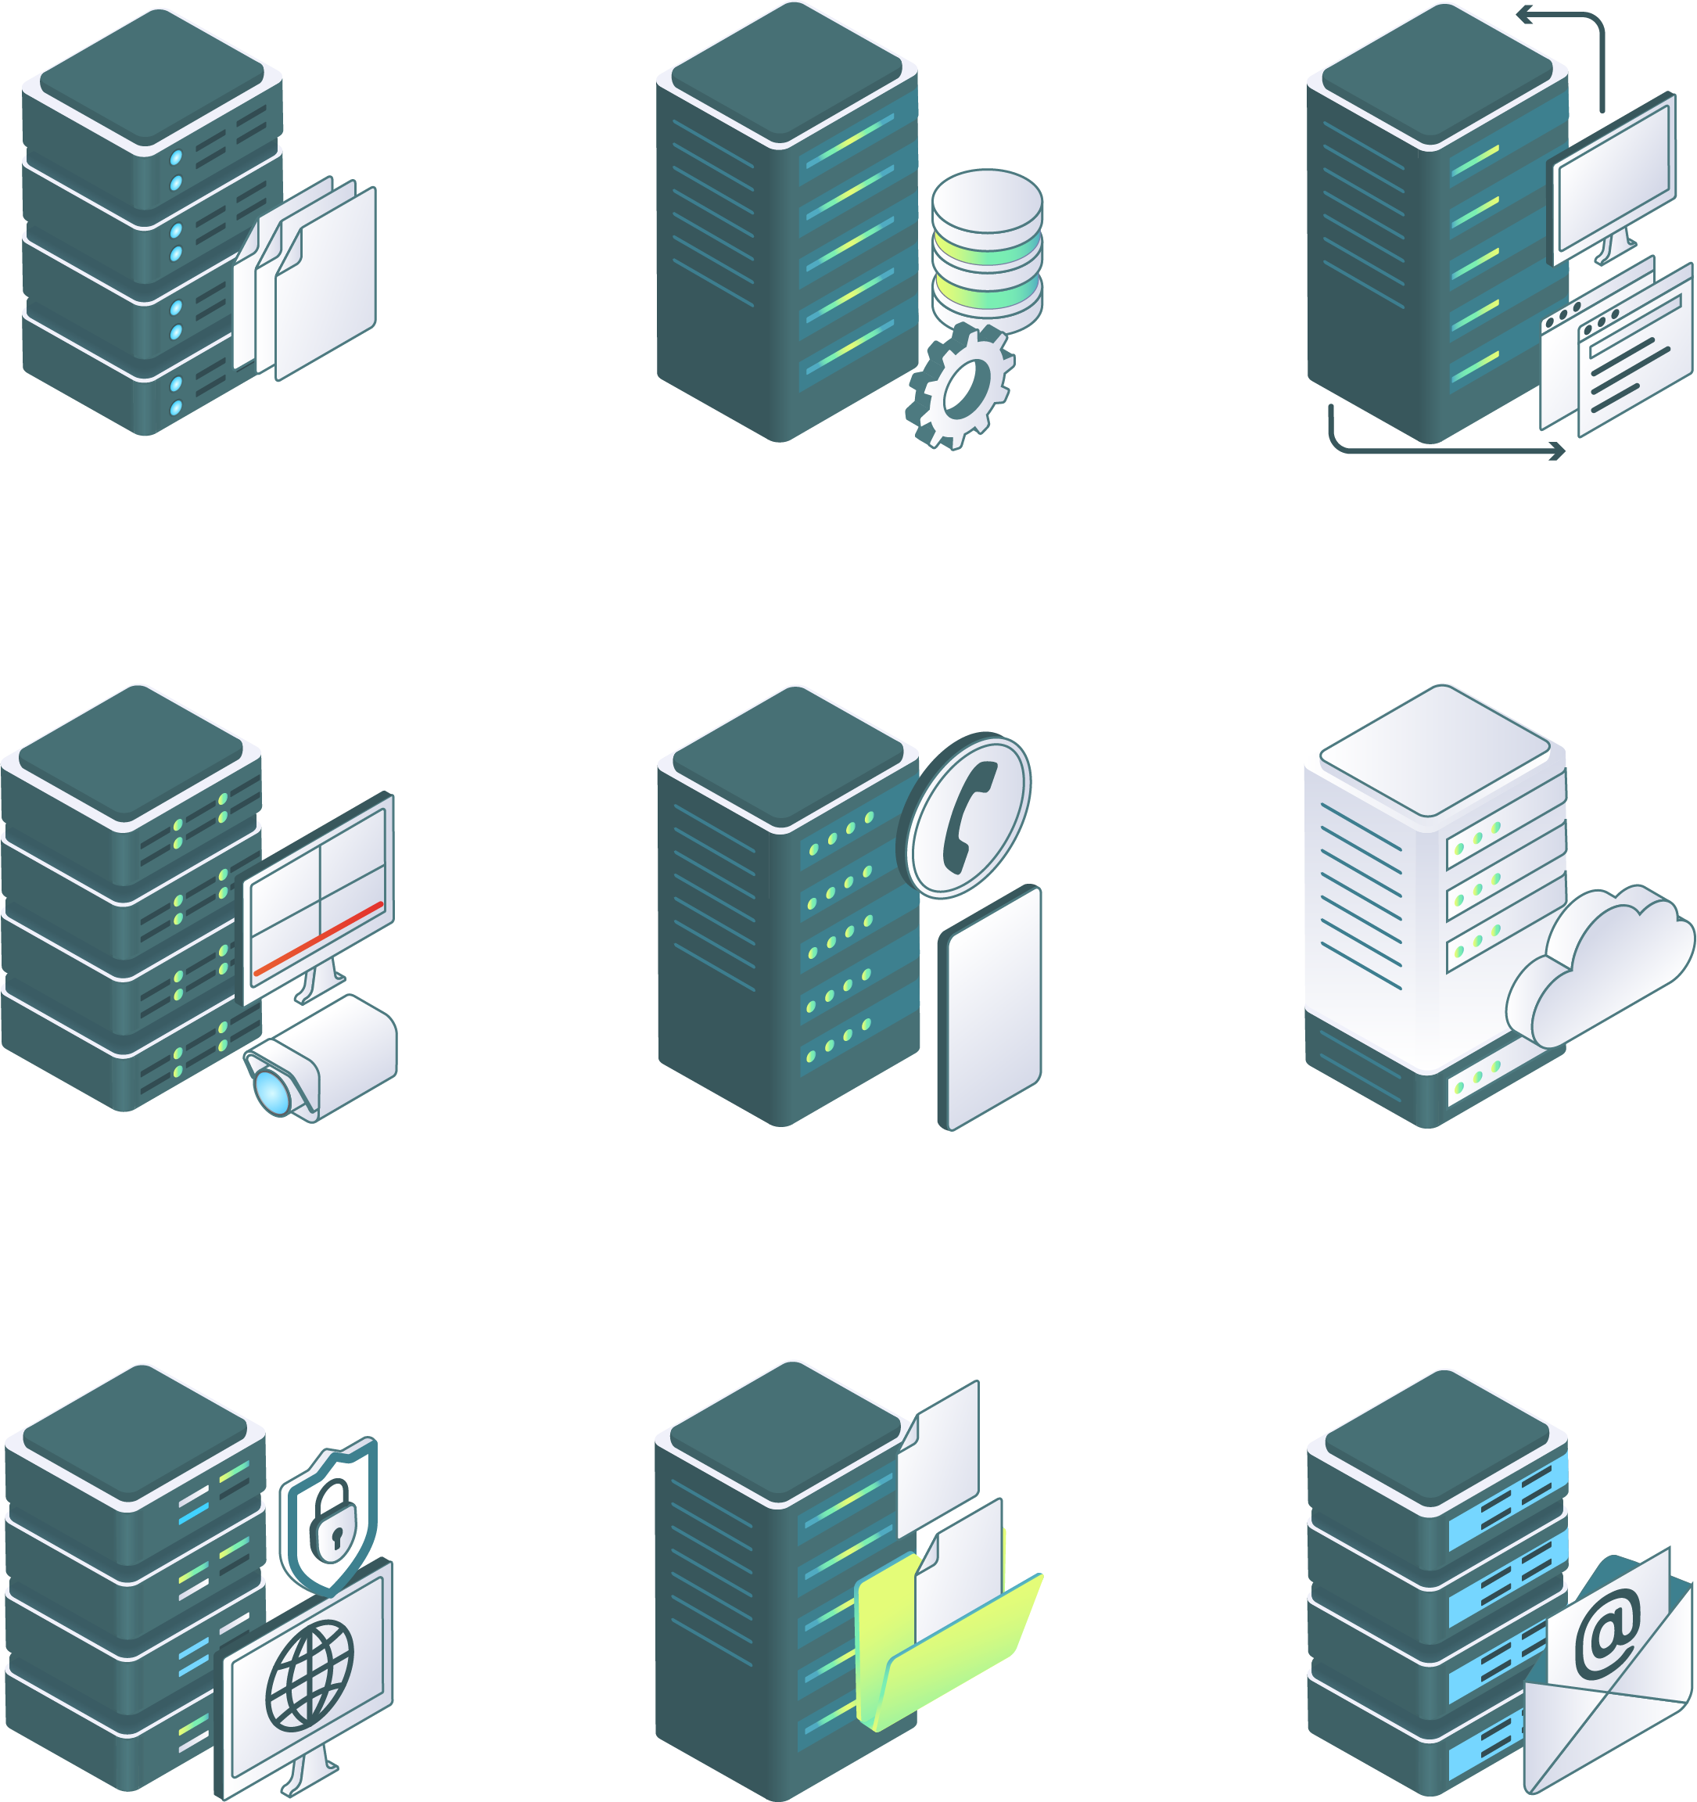
The Importance of Databases
Databases are so critical to web application architecture because they contain the persistent data that flows through the web application.
File Server
Database Server
Proxy Server
The data in the database can include, but isn't limited to:
Usernames, telephone numbers, and email addresses of customers.
Video Server
VOIP Server
Virtual Server
Session and cookie IDs of site visitors.
Personally identifiable information (PII), such as the full names, dates of birth, credit card numbers, and social security numbers of customers.
Virtual Private Network Server
FIle Transfer Protocol Server
Mail Server
61
Notes:
shutterstock_1713890323

Slide 62

The Importance of Databases
It is absolutely crucial that security professionals have a strong understanding of how databases work in web applications.
We’ll take a closer examination of the threats and vulnerabilities of databases next unit.
Notes:
shutterstock_1095422036

Slide 63
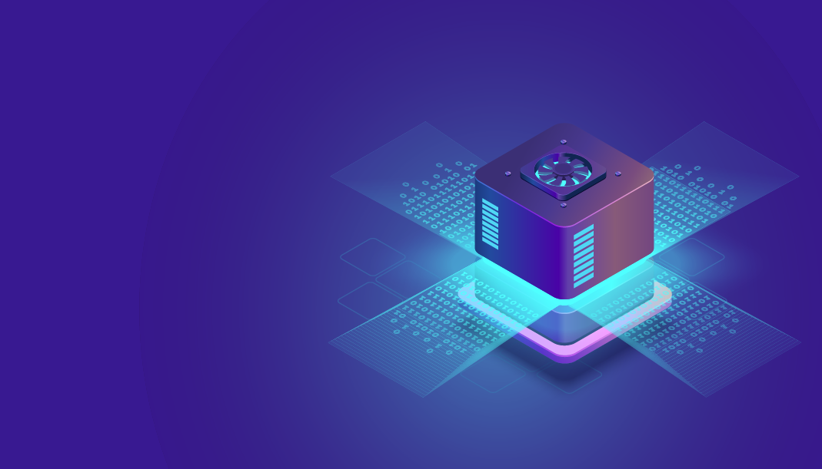
Databases Overview
Databases are used to store large amounts of data.
To assess threats and mitigate risks, we need to look at each component of an organization, and understand how malicious actors can exploit weaknesses and damage the stakeholders' finances, reputations, and well-being.
Notes:
shutterstock_1095389690

Slide 64
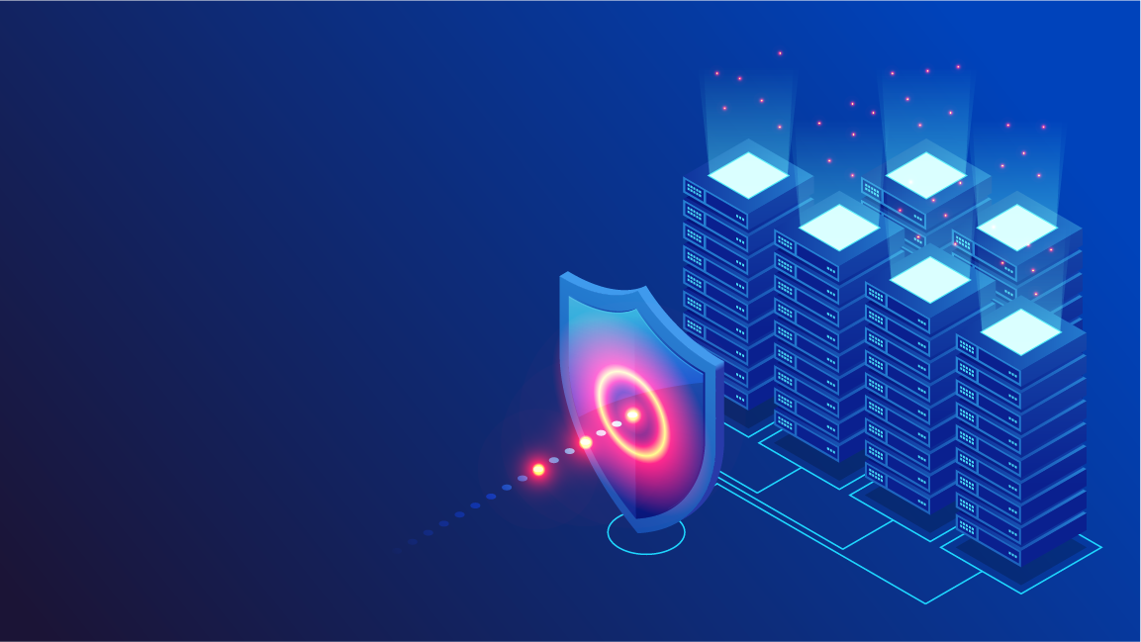
Database Overview
Databases are also typically kept separate from the other components of a web application.
Why we separate databases from other web apps:
Security
Compromise of one machine does not imply compromise of the other.
Scale
Many servers may use the same database.
64
Notes:
shutterstock_1299657616

Slide 65
As we saw in our last demo and activity, this was the case in our docker-compose.yml file.
compose
We had multiple defined services, and the database was its own container demo-db in the demo and db in the activity.
65

Slide 66
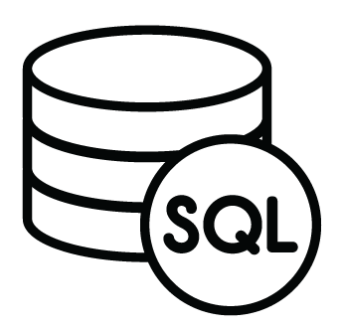
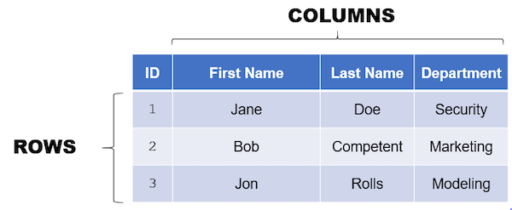



SQL Databases
While the two most important types of databases are SQL and NoSQL, we will be focusing only on SQL today.
SQL databases organize data like an spreadsheet.
Each column is a piece of data in the row.
Each row is an item in the database.
ID | First Name | Last Name | Department
1 | Jane | Doe | Security
2 | Bob | Competent | Marketing
3 | Jon | Rolls | Modeling
A whole “spreadsheet” of rows and columns is called a table.
ystem
S Q L
A collection of tables is called a database.
uery
anguage
Structured
Query
Language
66

Slide 67
Interacting with Data
Once you’ve created a table, there are four main ways to interact with the data it contains.
Create
Read
Update
Delete
CRUD
67
Notes:
shutterstock_226695271

Slide 68
Interacting with Data
Once you’ve created a table, there are four main ways to interact with the data it contains.
Create or add new entries to a database.
When a user makes a new account in a web app, they are creating a new database entry with their user info.
Create
Read
Update
Delete
CRUD
68
Notes:
shutterstock_226695271

Slide 69
Interacting with Data
Once you’ve created a table, there are four main ways to interact with the data it contains.
Read or view entries in a database.
When a web application verifies your login credentials, it is reading the credentials saved in the database.
Create
Read
Update
Delete
CRUD
69
Notes:
shutterstock_226695271

Slide 70
Interacting with Data
Once you’ve created a table, there are four main ways to interact with the data it contains.
Update or modify existing data in a database.
When you need to reset your password in a web application, the password entry (more specifically, the hashed password) is updated with the new password.
Create
Read
Update
Delete
CRUD
70
Notes:
shutterstock_226695271

Slide 71
Interacting with Data
Once you’ve created a table, there are four main ways to interact with the data it contains.
Delete or destroy data in the database.
If you have the option to delete your account from a web application (for example, on a GDPR web app), your account info is deleted from the database.
Create
Read
Update
Delete
CRUD
71
Notes:
shutterstock_226695271

Slide 72

CRUD
Together, these are as known as CRUD operations. These operations are also known as queries.
We'll use the term “query” to describe any input that will interact with data.
Next unit, we’ll come back to the the SQL syntax of these operations to set the stage for SQL injections.
SQL injections are a type of web application attack intended to manipulate queries so that an attacker can use a database in ways the developers did not originally intend.
72
Notes:
shutterstock_1335132566

Slide 73

Now that we understand high-level database operations, let’s see how we can create and enter queries into a web application's database to carry out basic database administration tasks.
Notes:
Image source: shutterstock_1083618569

Slide 74
Database Demo
In this demo, we’ll complete database administration tasks:
01
Deploy a web application.
02
Navigate to the web application's page to see what data can be viewed by a web client.
03
Start a bash session in the database's container and log into the database.
04
Use an SQL query to retrieve the contents of the database's primary table.
05
Modify that SQL query to find specific data.
06
Add new data to the database.
07
Delete data from the database.
74

Slide 75
Database Administration
75

Slide 76
Activity: Database Management
In this activity, you will locally deploy GoodCorp’s employee directory website with Docker Compose and manage the data inside the database.
25 Minutes
76

Slide 77
77

Slide 78
Next Week
In Unit 15, we will use the Web Vulnerabilities Azure Lab environment.
Inside the Web Vulnerabilities environment are two nested VMs: a Kali Linux instance and a machine called owaspbwa.
The owaspbwa machine hosts the vulnerable web applications that we will use throughout the class, but we do not log into it.
Instead, we will perform all of our work on the Kali Linux instance.
Student credentials for the Kali machine:
Username: sysadmin
Password: cybersecurity
Take a moment to set up and access this environment. Troubleshoot any issues before class next week.
78

